Slide 1



Blockchain Lesson 8
HTML / Javascript Fund Me

Slide 2



Requirement
- git
You'll know you've installed it right if you can run:
git --version
- Metamask
This is a browser extension that lets you interact with the blockchain.
- Nodejs
You'll know you've installed nodejs right if you can run:
node --version And get an ouput like: vx.x.x
- Yarn instead of npm
You'll know you've installed yarn right if you can run:
yarn --version And get an output like: x.x.x
You might need to install it with npm

Slide 3
Typescript
For this demo project, we do not have a typescript edition. Please see the NextJS projects for a professional typescript front end.

Slide 4


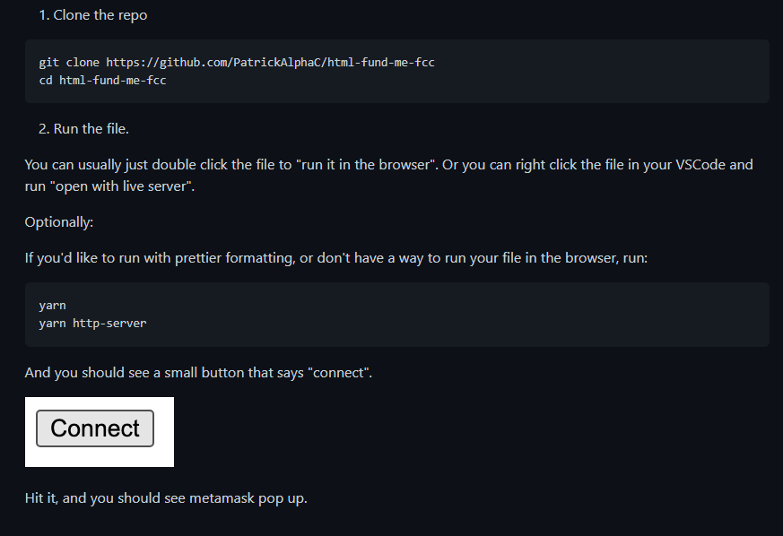
Quickstart

Slide 5
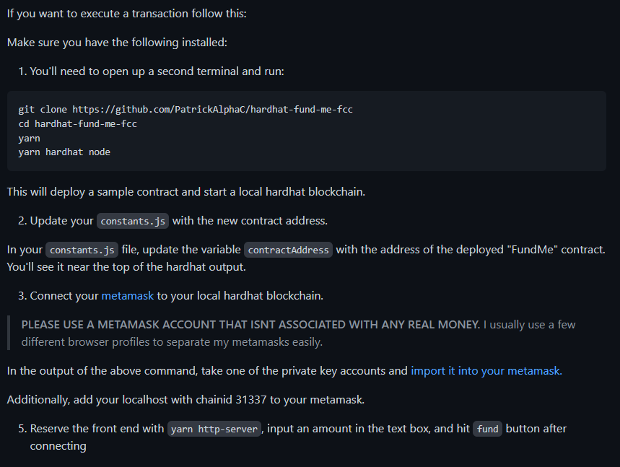
Execute Transaction

Slide 6

Connnecting to MetaMask
Connecting" or "logging in" to MetaMask effectively means "to access the user's Ethereum account(s)".
You should only initiate a connection request in response to direct user action, such as clicking a button. You should always disable the "connect" button while the connection request is pending. You should never initiate a connection request on page load.
We recommend that you provide a button to allow the user to connect MetaMask to your dapp. Clicking this button should call the following method:

Slide 7
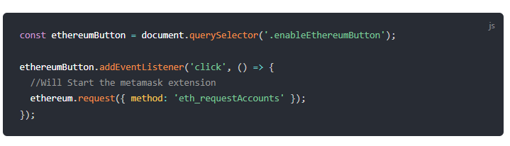
Connnecting to MetaMask

Slide 8
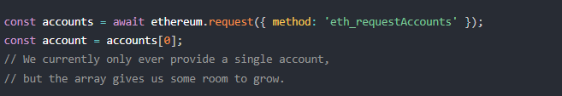
Connnecting to MetaMask
This promise-returning function resolves with an array of hex-prefixed Ethereum addresses, which can be used as general account references when sending transactions.
Over time, this method is intended to grow to include various additional parameters to help your site request everything it needs from the user during setup.
Since it returns a promise, if you're in an async function, you may log in like this:

Slide 9
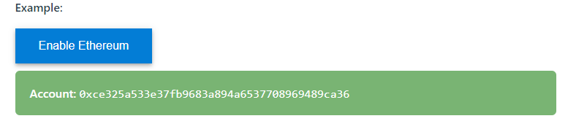
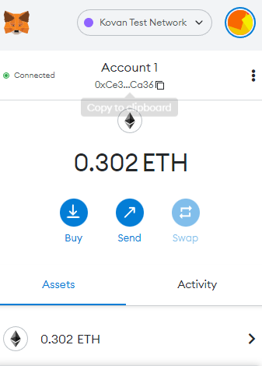
Example

Slide 10
Example

Slide 11
RESET ACCOUNT
MetaMask - RPC Error:
[ethjs-query] while formatting ouputs from RPC '{"value":{"code":-32603,"data":{"code":-32000,"message":"Nonce too high. Expected nonce to be 2 but got 4. Note that transactions can't be queued when automining."}}}'

Slide 12
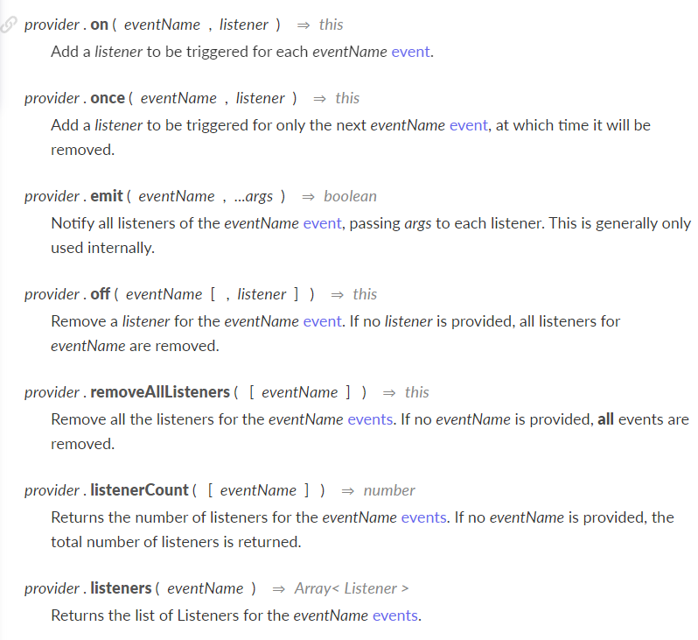
LISTENING FOR EVENT AND COMPLETE TRANSACTION

Slide 13
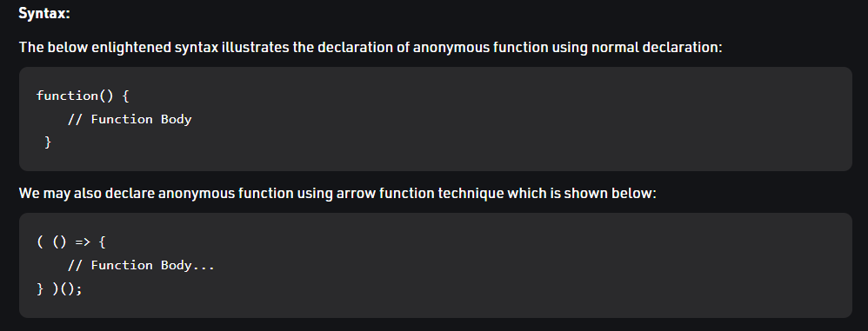
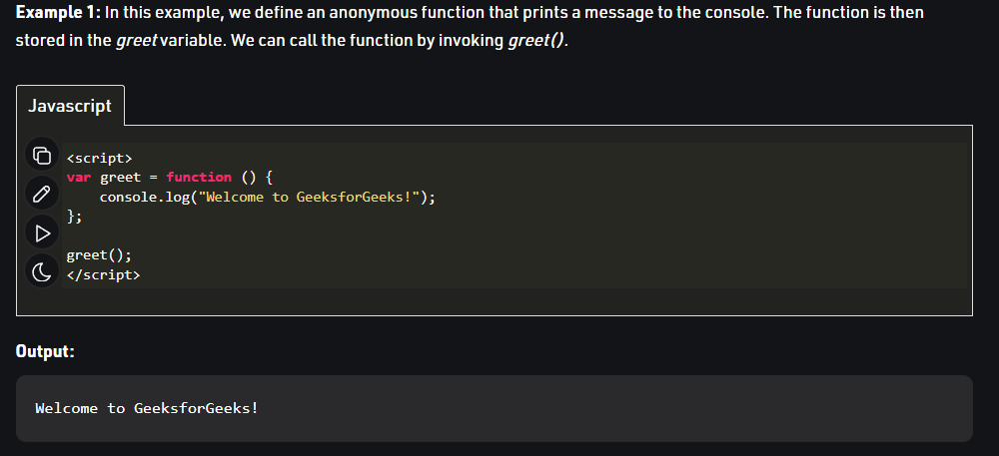
LISTENING FOR EVENT AND COMPLETE TRANSACTION

Slide 14
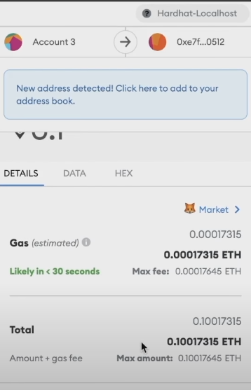
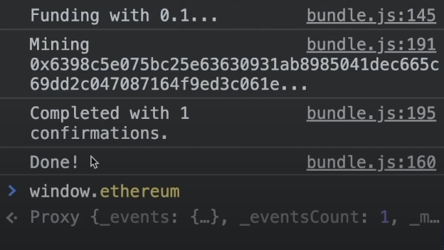
Summary

